Slide 1

Air Quality Control Using Arduino
Department of ELectronics of and Telecommunication
Dayananda Sagar College of Engineering.
2023-24
By-Sri Sumukha (1DS20ET058)
Manoj Shastri(1DS20ET044)
Praveen Raj(1DS20ET051)
Nasir Khan(1DS20ET047)
Project Guide:Dr.GanashreeTS (Associate Professor)

Slide 2
Table of Contents
1)Abstract
2)Introduction
3)Objectives
4)Methodology
5)Hardware/Software
6)Expected Results
7)Applications
8)Reference

Slide 3
Abstract
Environmental air parameters directly affect our daily quality of life, and they can change from day to day or even hour to hour.
With rapid industrialization over the past few decades, there is a dramatically increasing demand for people to monitor the local air quality to know how they live and what they breathe.
In this work, we proposed an air monitoring system based on the Arduino platform.
This environmental air monitoring system is designed to provide an efficient, straightforward and robust solution to monitor the air quality continuously and in real-time. It is a portable system that integrates multiple sensors into a single unit and can be placed anywhere.

Slide 4
Introduction
The atmosphere is a chaotic system, air condition is influenced by many factors and can change quickly. Air condition and quality directly affect people’s daily lives, such as their commute to work and the safety of outdoor activities.
Therefore, it is useful to develop a single mobile device that is a fully automated mobile device that can capture measurements at any location for short-term and long-term analysis. This proposed environmental monitoring system can give real time measurements of 5 air parameters and record the results on a host computer for future studies.
The system integrates O2、Dust、CO2、temperature and humidity sensors into one single
unit and utilizes an Arduino Uno R3 as the controller component.
The proposed system provides a user friendly, low cost, and portable solution to monitor multiple environmental air parameters.

Slide 5
Project objective
To study and understand the process of particle detection by arduino
Implementation of gp2y1010 Dust and Particulate Matter Sensor and sensors with arduino
Measurement of the quality of air
Real time measurement of the 5 data in any place

Slide 6
Methodology
This system works by collecting data of specific environmental parameters, including gas contents and the amount of dust present in the air. The system has five fixed sensors and an additional connection port for an extra gas sensor. The five fixed sensors monitor six types of air parameters: Dust, humidity, temperature, CO2, O2, . The extra sensor can be chosen from multiple types of gas sensors that are compatible with this device, such as CO, SO2, and O3.
In general, after sensor modules detect the air environmental variables, they generate either analog data or digital data depending on the sensor type for further processing. An analog to digital converter is utilized to convert analog data into a digital signal.

Slide 7
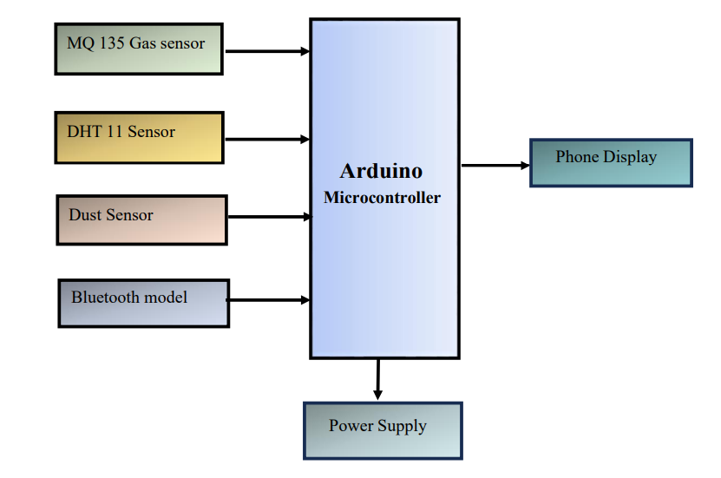
Block Diagram of the Proposed System

Slide 8
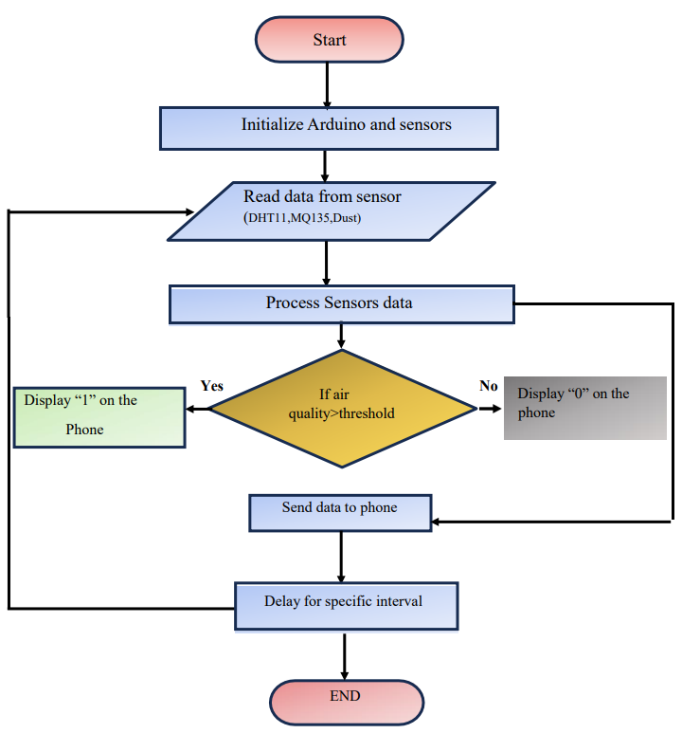
Flow Diagram Of the System

Slide 9
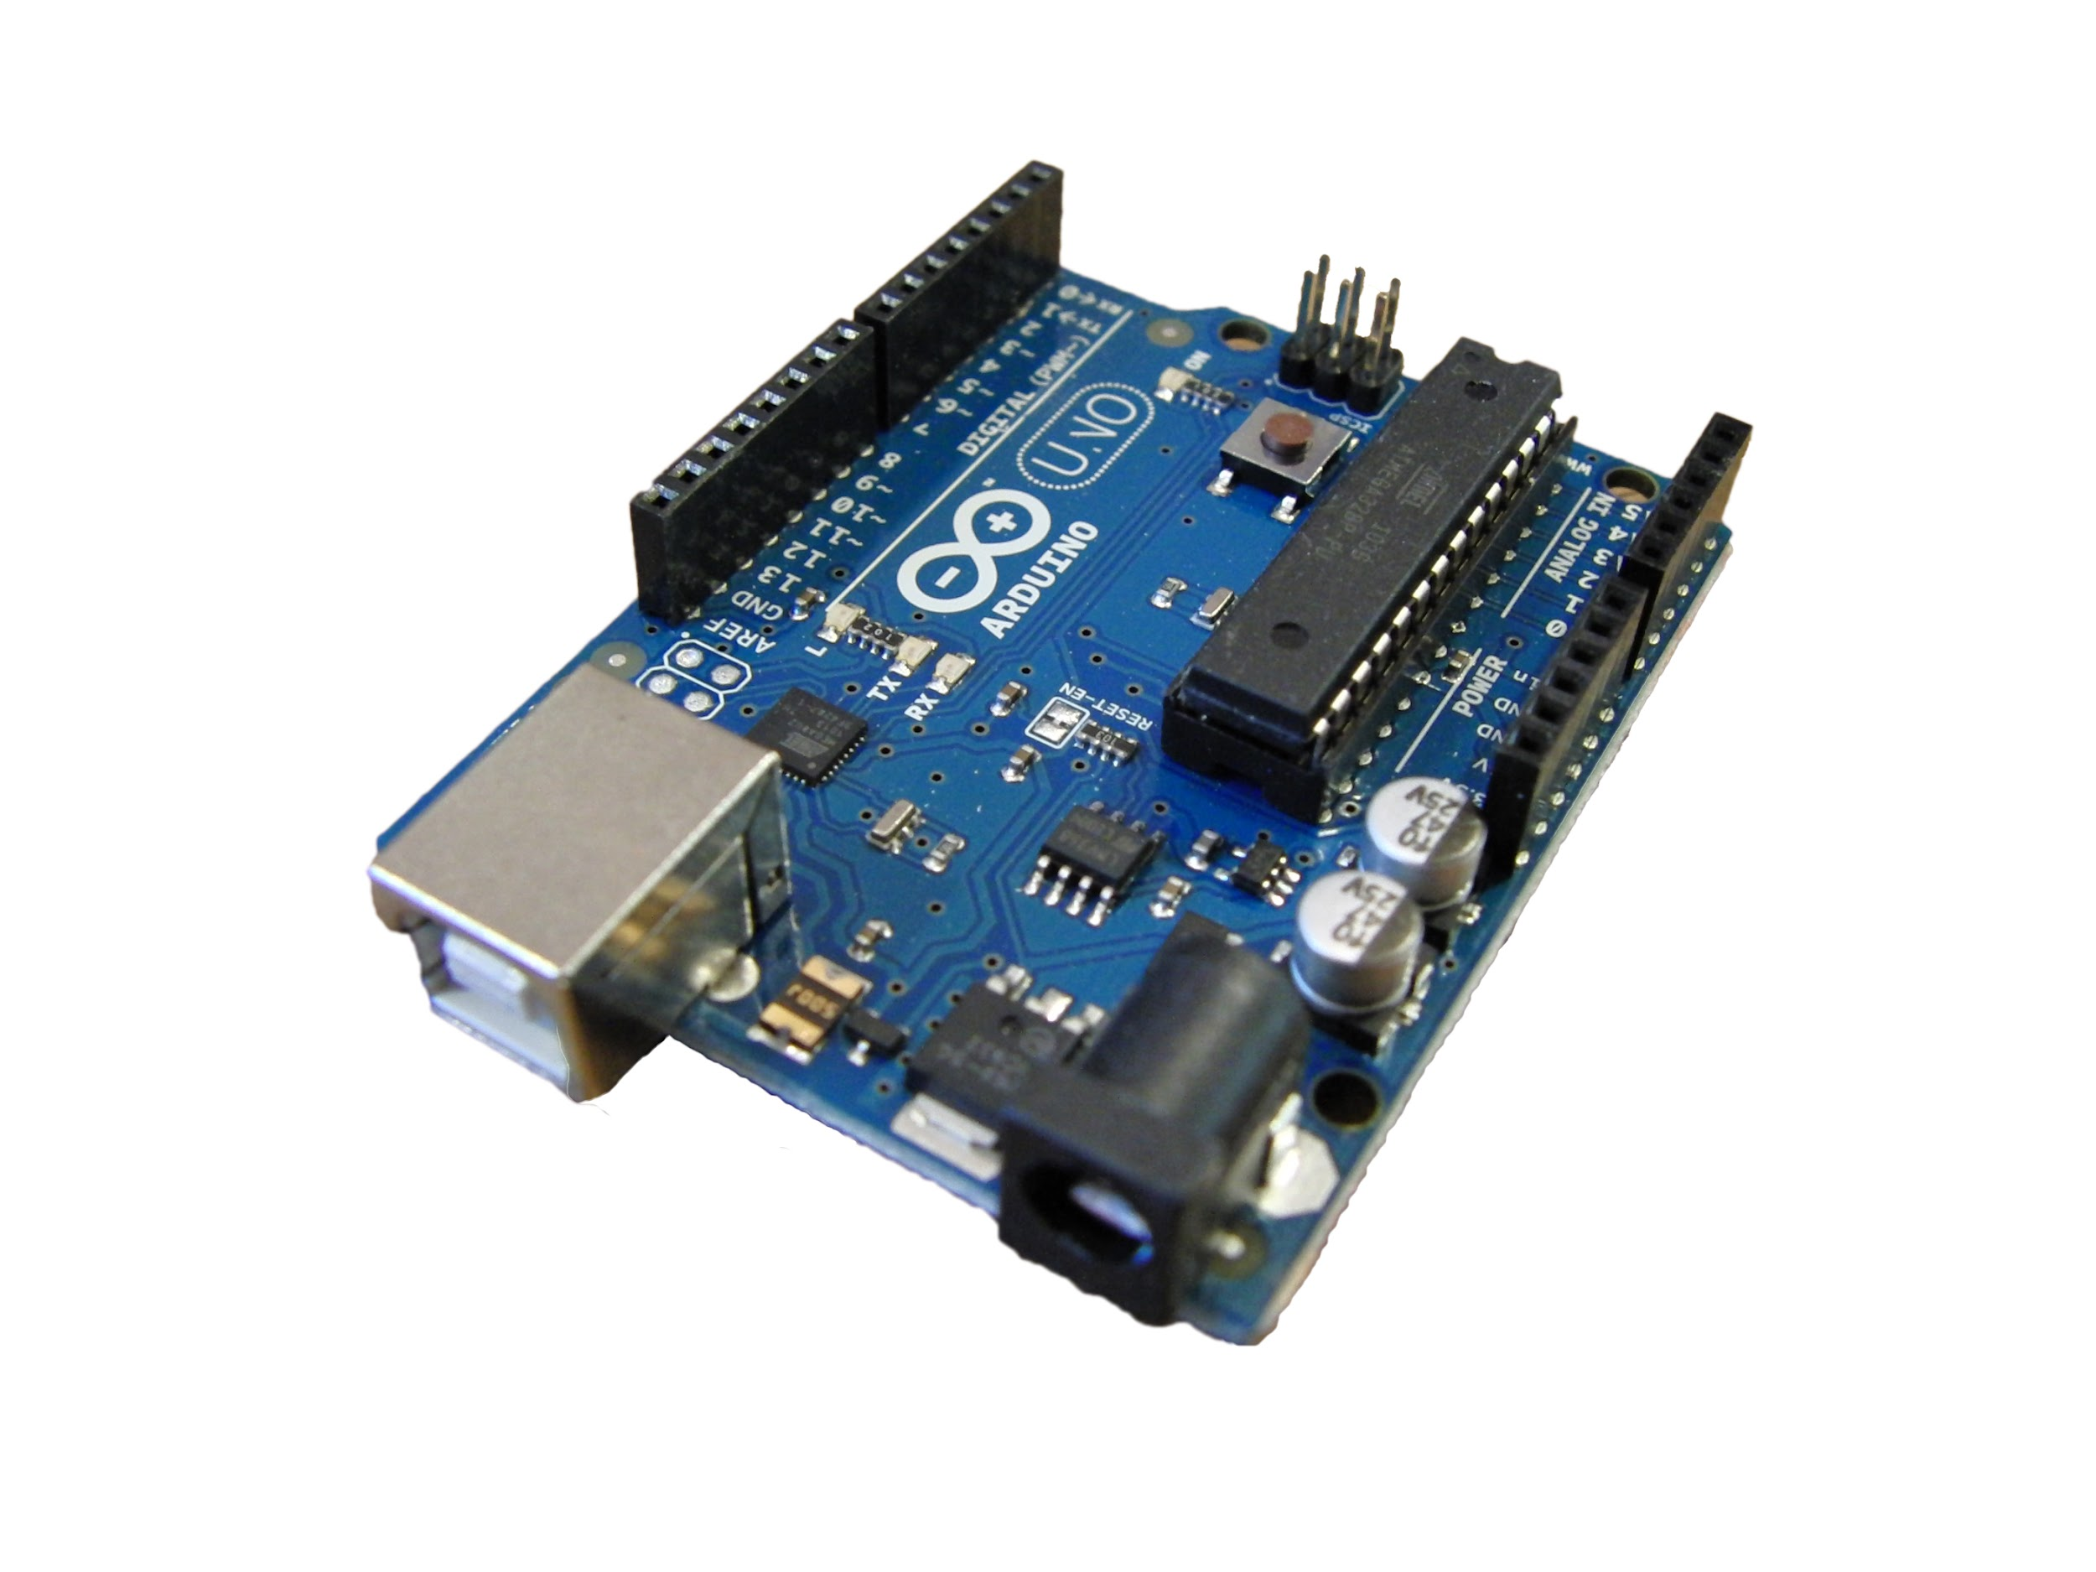
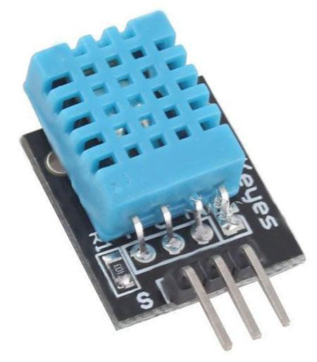
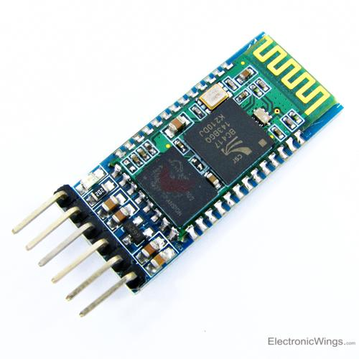
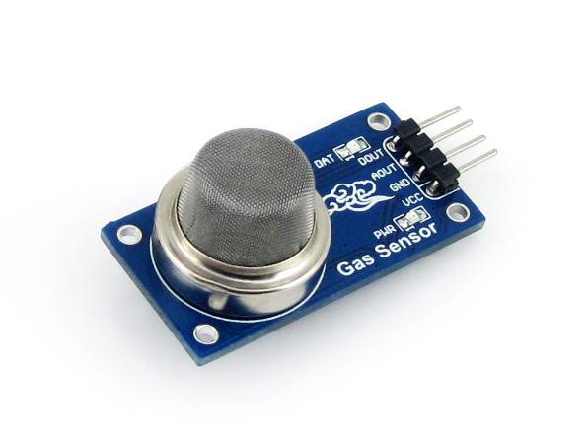
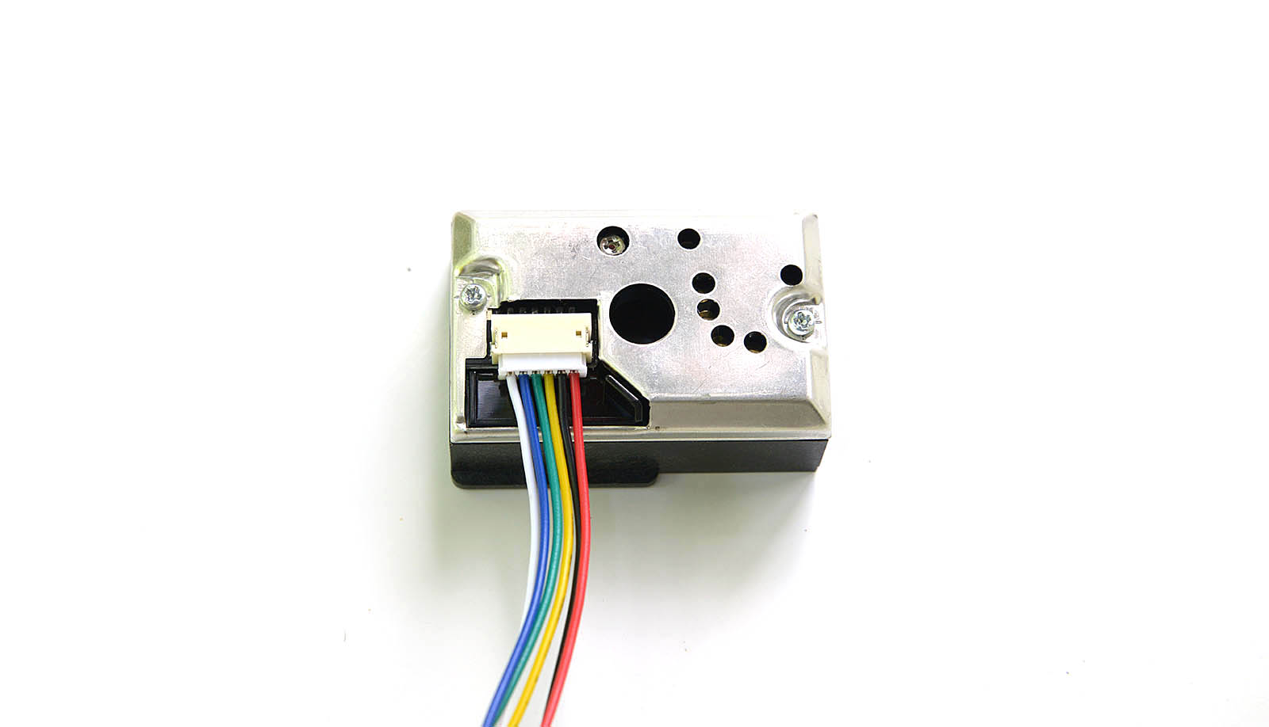
Hardware
Arduino UNO R3
DHT 11 Sensor
HC-05 Bluetooth Module
MQ 135 Gas Sensor
Gp2y1010 Dust Sensor

Slide 10
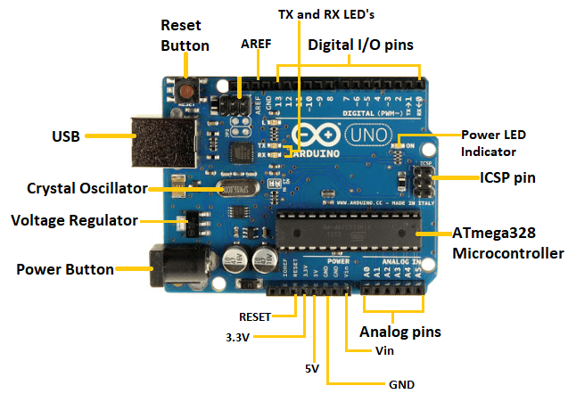
Arduino UNO R3
Arduino UNO is a microcontroller board based on the ATmega328P. It has 14 digital input/output pins (of which 6 can be used as PWM outputs), 6 analog inputs a 16 MHz ceramic resonator, a USB connection, a power jack, an ICSP header and a reset button. It contains everything needed to support the microcontroller; simply connect it to a computer with a USB cable or power it with a AC-to-DC adapter or battery to get started.
Arduino UNO R3

Slide 11
Arduino UNO R3
ATmega328 Microcontroller- It is a single chip Microcontroller of the ATmel family. The processor code inside it is of 8-bit. It combines Memory (SRAM, EEPROM, and Flash), Analog to Digital Converter, SPI serial ports, I/O lines, registers, timer, external and internal interrupts, and oscillator.
Power LED Indicator- The ON status of LED shows the power is activated. When the power is OFF, the LED will not light up.
Digital I/O pins- The digital pins have the value HIGH or LOW. The pins numbered from D0 to D13 are digital pins.
TX and RX LED's- The successful flow of data is represented by the lighting of these LED's.
AREF- The Analog Reference (AREF) pin is used to feed a reference voltage to the Arduino UNO board from the external power supply.
Reset button- It is used to add a Reset button to the connection.

Slide 12
Arduino UNO R3
USB- It allows the board to connect to the computer. It is essential for the programming of the Arduino UNO board.
Crystal Oscillator- The Crystal oscillator has a frequency of 16MHz, which makes the Arduino UNO a powerful board.
Voltage Regulator- The voltage regulator converts the input voltage to 5V.
GND- Ground pins. The ground pin acts as a pin with zero voltage.
Vin- It is the input voltage.
Analog Pins- The pins numbered from A0 to A5 are analog pins. The function of Analog pins is to read the analog sensor used in the connection. It can also act as GPIO (General Purpose Input Output) pins.

Slide 13
DHT 11 Sensors
The DHT11 is a commonly used Temperature and humidity sensor that comes with a dedicated NTC to measure temperature and an 8-bit microcontroller to output the values of temperature and humidity as serial data.
1 | VCC | Power Supply 3.5v to 5.5V
2 | Data | Outputs both Temperature and Humidity through serial Data
3 | GND | Connected to GND to Circuit
DHT 11 Sensor

Slide 14
DHT 11 Specifications
Operating Voltage: 3.5V to 5.5V
Operating current: 0.3mA (measuring) 60uA (standby)
Output: Serial data
Temperature Range: 0°C to 50°C
Humidity Range: 20% to 90%

Slide 15
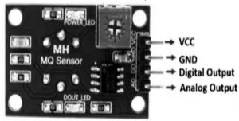
MQ 135 Gas Sensor
An MQ135 air quality sensor is one type of MQ gas sensor used to detect, measure, and monitor a wide range of gases present in air like ammonia, alcohol, benzene, smoke, carbon dioxide, etc. It operates at a 5V supply with 150mA consumption. Preheating of 20 seconds is required before the operation, to obtain the accurate output.
A0 | Analog Output
D0 | Digital Output
GND | Ground
VCC | Supply (5v)
MQ135 Air Quality Sensor Pin Configuration

Slide 16
MQ 135 Gas Sensor
Pin 1: VCC: This pin refers to a positive power supply of 5V that power up the MQ135 sensor module.
Pin 2: GND (Ground): This is a reference potential pin, which connects the MQ135 sensor module to the ground.
Pin 3: Digital Out (Do): This pin refers to the digital output pin that gives the digital output by adjusting the threshold value with the help of a potentiometer. This pin is used to detect and measure any one particular gas and makes the MQ135 sensor work without a microcontroller.
Pin 4: Analog Out (Ao): This pin generates the analog output signal of 0V to 5V and it depends on the gas intensity. This analog output signal is proportional to the gas vapor concentration, which is measured by the MQ135 sensor module. This pin is used to measure the gases in PPM. It is driven by TTL logic, operates with 5V, and is mostly interfaced with microcontrollers.

Slide 17
MQ 135 Gas Sensor Specifications
Operating Voltage is +5V
Detect/Measure NH3, NOx, alcohol, Benzene, smoke, CO2, etc.
Analog output voltage: 0V to 5V
Digital output voltage: 0V or 5V (TTL Logic)
Preheat duration 20 seconds
Can be used as a Digital or analog sensor

Slide 18
Gp2y1010 Dust Sensor
GP2Y1014AU0F is a tiny six-pin analog output optical air quality/optical dust sensor that is designed to sense dust particles in the air. It works on the principle of laser scattering. Inside the sensor module, an infrared emitting diode and a photosensor are diagonally arranged near the air inlet hole

Slide 19
Gp2y1010 Dust Sensor
Low Current Consumption: 20mA max
Typical Operating Voltage: 4.5V to 5.5V
Minimum Detectable Dust Size: 0.5µm
Dust Density Sensing Range: Up to 580 ug/m3
Sensing Time: Less than 1 Second
Dimensions: 1.81 x 1.18 x 0.69'' (46.0 x 30.0 x 17.6mm)

Slide 20
HC-05 Bluetooth Module
The HC05 bluetooth module is used as UART serial converter module and can easily transfer the UART data through the wireless bluetooth.
The Bluetooth module has a Frequency: 2.4GHz ISM band, PIO control and comes with an integrated antenna and edge connector.
The HC-05 bluetooth module can be used in master or slave configuration.

Slide 21
Software and Code
#include <Adafruit_Sensor.h>
#include <DHT.h>
#include <DHT_U.h>
#define DHTTYPE DHT11
// DHT 11
#define DHTPIN 5
DHT_Unified dht(DHTPIN, DHTTYPE);
uint32_t delayMS;
#include <SPI.h>
#include <Adafruit_GFX.h>
#include <Adafruit_SSD1306.h>
int sensorValue;
int digitalValue;
int sensePin = A5;
float outVo=0;
float sigVolt=0;
float dustLevel=0;

Slide 22
void setup()
{
Serial.begin(9600); // sets the serial port to 9600
dht.begin();
sensor_t sensor;
delayMS = sensor.min_delay / 1000;
pinMode(13, OUTPUT);
pinMode(2, INPUT);
outVo = analogRead(sensePin);
sigVolt = outVo*(5.0/1024);
dustLevel = 0.17 * sigVolt - 0.1;
}

Slide 23
void loop()
{
sensorValue = analogRead(0); // read analog input pin 0
digitalValue = digitalRead(3);
if (sensorValue > 400)
{
digitalWrite(13, HIGH);
}
else
digitalWrite(13, LOW);
Serial.print("-");
Serial.print("The Quality of air is :");
Serial.print(sensorValue, DEC);
Serial.println(" ppm");// prints the value read
Serial.print("The value of the MQ135 Digital sensor is :");
Serial.println(digitalValue, DEC);
if(digitalValue == 0){
Serial.println("No Harmful Gases Detected");
}
else{
Serial.println("HarmfulGases Detected");
}

Slide 24
sensors_event_t event;
dht.temperature().getEvent(&event);
Serial.print(F("Temperature: "));
Serial.print(event.temperature);
Serial.println(F("°C"));
dht.humidity().getEvent(&event);
Serial.print(F("Humidity: "));
Serial.print(event.relative_humidity);
Serial.println(F("%"));
Serial.print("The value from the sensor is :");
Serial.println(outVo);
Serial.print("The value signal voltage :");
Serial.println(sigVolt,4);
Serial.print("The Dust Density is :");
Serial.println(dustLevel,4);
delay(delayMS);
delay(1000); // wait 100ms for next reading
}

Slide 25
Expected Results
The Quality of the Air present is measured in Parts Per Million
The Temperature and Humidity of the Air are measured in Real-time
Detection of Harmful gases like Carbon dioxide, Ammonia and others are detected
The dust Density of the present Air is measured in ug/m3

Slide 26
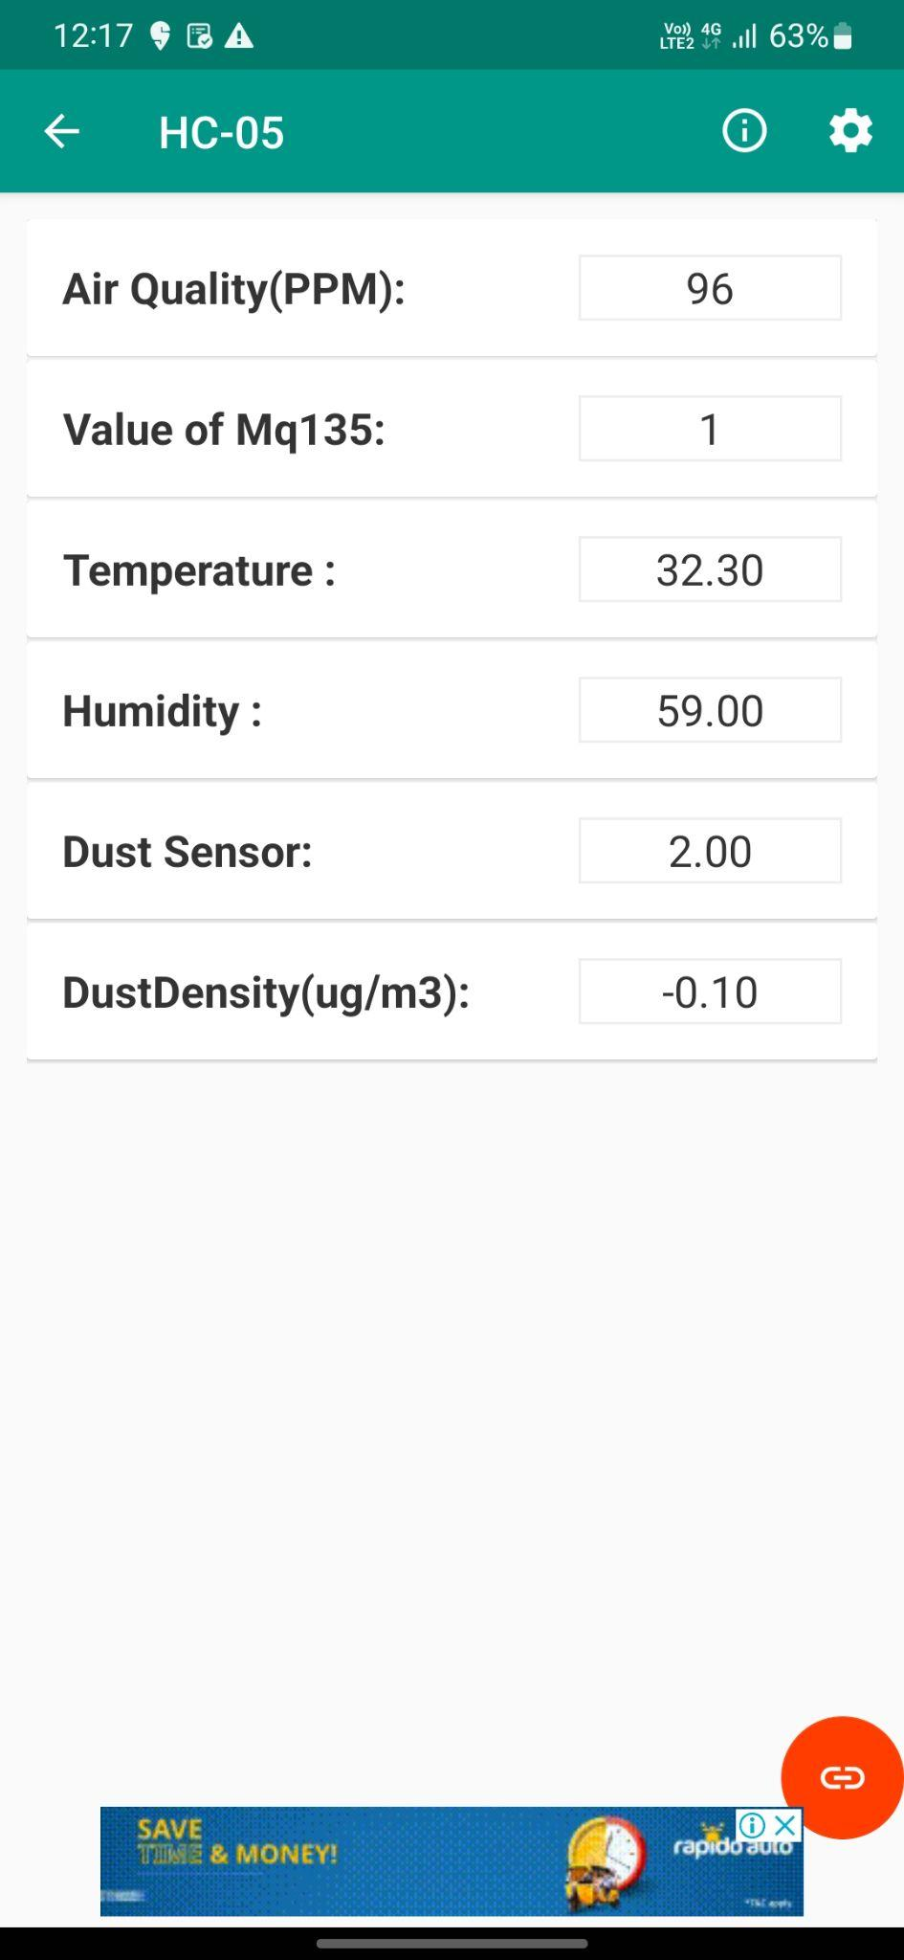
Result Screen Observed in the Mobile Device

Slide 27
Applications
1) Indoor Air Quality Monitoring System
2) Outdoor Air Quality Monitoring System
3) Particulate Matter Monitoring
4) Gas Detection System:

Slide 28
References
A SURVEY PAPER ON AIR POLLUTION MONITORING USING IOT 1 Pattar Sunil Mahesh. 2 Patil Bhushan Rajendra 3 Bodke Akshay Dnyaneshwar 4 Mr. Ulhās. V. Patil 1Pattar Sunil Mahesh, Patil Bhushan Rajendra, 3 Bodke Akshay Dnyaneshwar 5Mr.Ulhas. A. Patil, Electronics & Telecommunication, SIR VISVESVARAYA INSTITUTE OF TECHNOLOGY, Maharashtra, INDIA
Aware of Air: Measuring Local Air Quality using Portable Arduino-based Sensors by Nikhil Devanathan
AIR QUALITY MONITORING SYSTEM Arsh Meharwal1, Anurag Sharma2, Ankit Kumar3, Anshul Singhal4 1-4Dept. of ECE, ABES Engineering College, Ghaziabad, India
IMPLEMENTATION OF INDOOR AIR QUALITY MONITORING SYSTEM USING IOT AND GSM 1K.Durga Anudeepika,2K.Durga Devi,3M.Kamala,4D.Swetha, 5Dr.E.V.Krishna Rao 1Student,2Student,3Student,4Student,5Professor,Dean of
Academics 1Department of Electronics and Communication Engineering LakireddyBalireddy College of Engineering,Vijayawada,India.
Air Quality Monitoring System Ramik Rawal School of Computer Science and Engineering (SCOPE), Vellore Institute of Technology, Gorbachev Road, Vellore, Tamil Nadu 632014, India.

